Slide 1










Evolution of Intel Processors
From 4004 to Core Ultra
By : Rafif Ahmad Yudhistira (3124500045)
Based on https://www.youtube.com/watch?v=PT787d9odKk

Slide 2
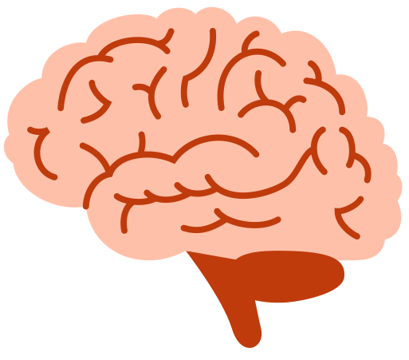



Introduction
The Evolutionary Journey of Intel Processors
Key metrics for improvement:
- Transistor count
- Clock speed
- Power efficiency
- Architectural innovations
Importance of processor evolution in computing history
Intel's role as industry pioneer since 1968
1
2
3

Slide 3




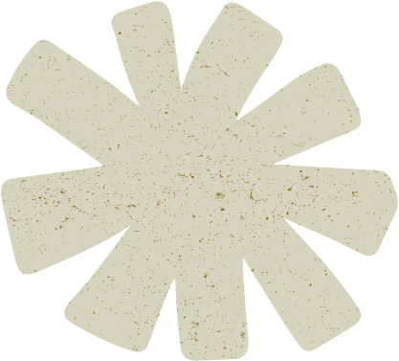




Timeline
1971-1989
1990s
2000-2005
Milestone Processors:
4004 (1971)
First microprocessor
2,300 transistors
740kHz clock speed
8086 (1978)
First x86 architecture
29,000 transistors
5-10MHz
Key Developments:
Pentium (1993)
Superscalar architecture
3.1 million transistors
60-200MHz
Pentium Pro (1995)
Out-of-order execution
RISC core with x86 decoder
Notable Processors:
Pentium 4 (2000)
NetBurst architecture
Hyper-Threading introduced
3.8GHz peak clock speed
Challenge: Power consumption and heat issues

Slide 4
Timeline
2006-2010
2011-2016
2017-Present
Paradigm Shift:
Core 2 Duo (2006)
Return to P6 microarchitecture
First dual-core mainstream CPU
65nm to 45nm process
Nehalem (2008)
Integrated memory controller
Turbo Boost technology
Recent Advancements:
Hybrid Architecture (Alder Lake)
Performance + Efficiency cores
Intel 7 process (10nm Enhanced)
AI Integration
DL Boost instructions
NPU in Core Ultra
Intel's Development Strategy:
Tick: Process shrinkage (22nm Ivy Bridge)
Tock: Architectural improvements (Haswell)
Key Innovations:
3D Tri-Gate transistors
AVX instructions
Power-optimized designs

Slide 5




Future Directions
Upcoming Technologies :
- Intel 20A (2nm class)
- PowerVia backside power delivery
- Quantum computing research
Challenges :
- Moore's Law slowdown
- Competition from ARM/RISC-V

Slide 6




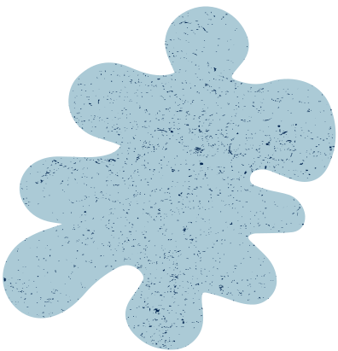
Conclusion
From Humble Beginnings
1971's 4004 (2,300 transistors) to today's Core Ultra (billions of transistors)
Clock speeds increased from kHz to GHz, now optimizing for efficiency
Architectural Revolution
Evolved from single-core to hybrid (P-core/E-core) designs
Pioneered technologies: Hyper-Threading, Turbo Boost, AI acceleration
Industry Impact
Enabled personal computing → cloud computing → AI era
Continues to push boundaries with Quantum and neuromorphic research
Future Challenges
Sustaining Moore's Law with 3D stacking and new materials
Competition in ARM/RISC-V ecosystems
the
Peppered
Moth

Slide 7
Thank you!

